Slide 1
Classification and Impact of Fragility Fractures
SC-AT-AMG162-00711 Oct 2020

Slide 2
Overview

Slide 3
Classifications and Definitions

Slide 4
Fragility Fractures Include Clinical Fractures and Asymptomatic (Morphometric) Vertebral Fractures

Slide 5
Clinical Fractures Are Fragility Fractures That Come to Clinical Attention

Slide 6
Vertebral Fractures Are Often Initially Asymptomatic¹⁻³

Slide 7
Influence of Prior Fractures on the Risk of Future Fractures

Slide 9
Fragility Fractures Reveal Underlying Skeletal Weakness¹ and Are Strong Predictors of Future Fracture Risk, Among Other Risk Factors

Slide 10
A Prior Fracture Can More Than Double the Relative Risk of a Future Fracture

Slide 11
Prior Fractures Are Common in Older Women Including Those With Hip Fracture

Slide 12
The WHO Fracture Risk Assessment Tool (FRAX®) Recognizes the Importance of Prior Fracture on Future Fracture Risk

Slide 13
Prior Fracture Is a Common and Impactful Clinical Risk Factor for Future Fractures

Slide 14
In Addition to Prior Fracture, Age, Low BMD, and Other Nonmodifiable and Modifiable Risk Factors Also Contribute to Future Fracture Risk

Slide 16
The Incidence of Future Fracture Rises With Each Prior Fracture

Slide 17
The Risk of Future Clinical Fractures Is Higher in Those With Multiple Prior Fractures

Slide 19
Women With a Prior Hip Fracture Have a 3-fold Greater Risk of a Subsequent Hip Fracture

Slide 20
Women With a Prior Clinical Vertebral Fracture Have a 7-fold Greater Risk of Additional Vertebral Fractures¹

Slide 21
A Prior Clinical Fracture Can Increase the Risk of a New Clinical Fracture by 85%

Slide 22
Prior Vertebral Fractures Increase the Risk of Subsequent Nonvertebral Fractures

Slide 23
Prior Non-Vertebral Fractures Increase the Risk of Subsequent Fractures at Different Sites

Slide 24
Burden of Fragility Fractures

Slide 26
About 9 Million Fragility Fractures Occur Worldwide Every Year

Slide 27
Fragility Fractures Are Associated With Substantial Clinical Burden vs Some Other Common Serious Illnesses

Slide 28
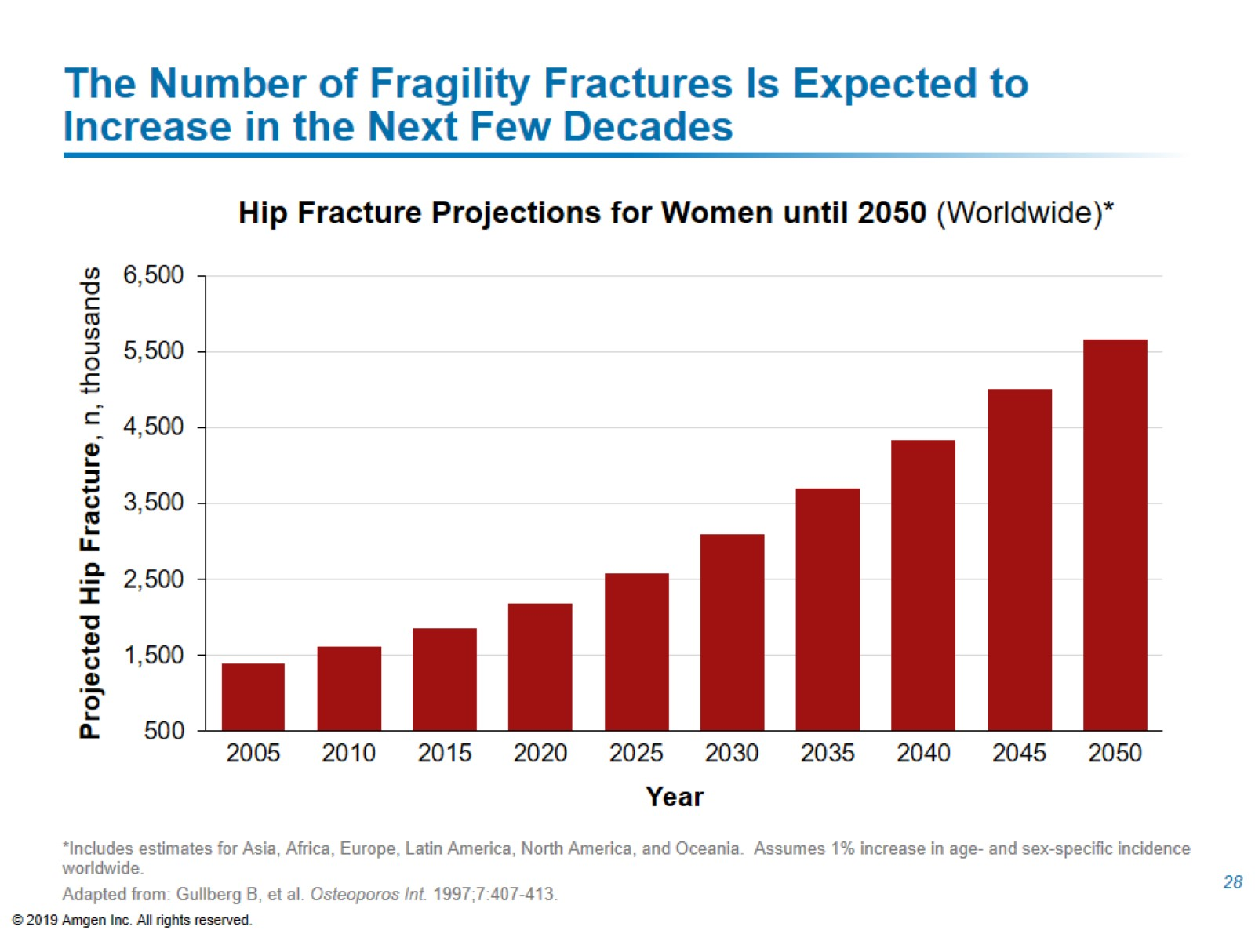
The Number of Fragility Fractures Is Expected to Increase in the Next Few Decades

Slide 30
Fragility Fractures Are Associated With Increased Mortality

Slide 31
Risk of Mortality Continues to Rise in the Years Following an Initial Fracture at the Hip or Vertebra

Slide 32
Excess Mortality Risk Persists for > 5 Years After Proximal Fractures and > 10 Years After Hip Fractures

Slide 33
After a Hip Fracture, Nearly 25% of Patients Will Die Within 1 Year and Mortality Remains Elevated for at Least 8 Years¹⁻⁶

Slide 34
Clinical Vertebral Fractures Can Be Associated With Up to an 8-fold Increase in Relative Risk of Mortality in the Year After Fracture

Slide 36
Fragility Fractures at the Hip and Vertebrae Are Associated With Increased Admission to Nursing Homes and Other Types of Long‑term Care Facilities

Slide 37
Fragility Fractures at the Pelvis, Wrist, and Humerus Are Associated With Increased Admission to Nursing Homes and Other Types of Long‑term Care Facilities

Slide 38
Fragility Fractures, Particularly Hip and Vertebral, Are Associated With Non-skeletal Clinical Sequelae

Slide 39
Hip Fractures Are Associated With Functional Disability and Reduced Ability to Perform Activities of Daily Living

Slide 40
Fragility Fractures at Various Sites Are Associated With Lower Quality of Life and Reduced Physical Function

Slide 41
Worry About Fractures and Nursing Home Admissions Can Be a Source of Anxiety and Other Negative Feelings for a Patient After Fracture

Slide 42
Fragility Fractures Can Place a Heavy Cost Burden on Patients and Caregivers

Slide 44
The Economic Burden of Illness of Fragility Fractures Exceeds Many Other Common Diseases

Slide 45
Direct Costs Associated With Fragility Fractures Are High and Expected to Rise in the Future

Slide 46
Indirect Costs of Fragility Fractures Include Post‑fracture Nursing Home Costs and Sick Leave

Slide 47
Fragility Fractures Lead to a Reduction in Productivity in the Workplace for Patients and Caregivers

Slide 48
Summary Classification and Impact of Fragility Fractures

